Slide 1
Data Structures & Algorithms (CSC-214)
Lec 3: Pointers recap

Slide 2
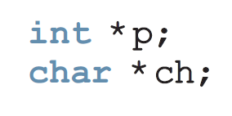
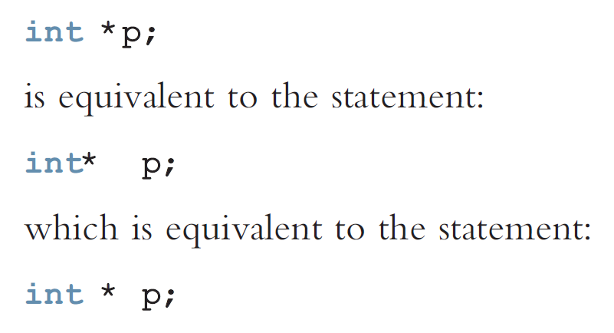
Pointer variable: A variable whose content is a memory address.

Slide 3
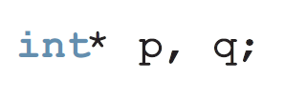
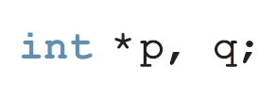
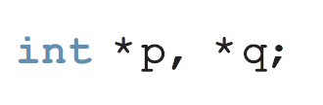
Only p is the pointer variable
So just attach the * to the variable name to be very clear.

Slide 4
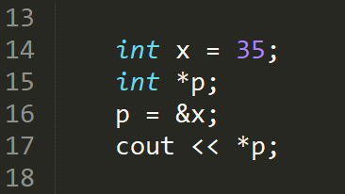
Address of operator & dereferencing operator *
Address of
Dereference
Notes:
Answer: 35

Slide 5
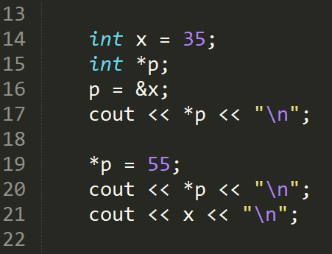
Example (2)
Notes:
Answer:
35
55
55

Slide 6
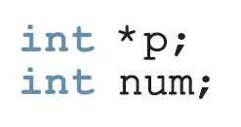
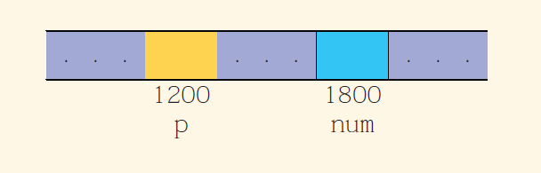
Example (3)

Slide 7
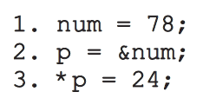
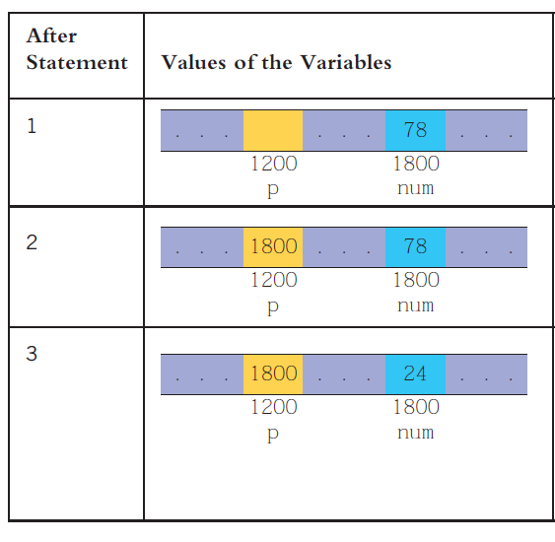
Example (3)

Slide 8
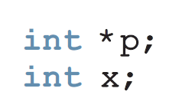
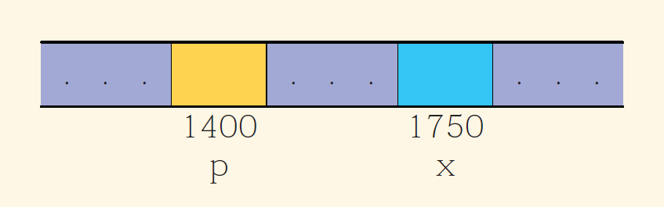
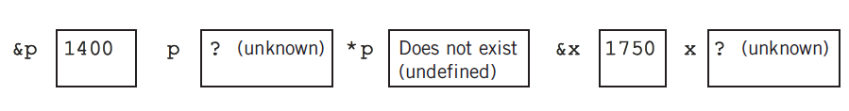
Example (4)

Slide 9
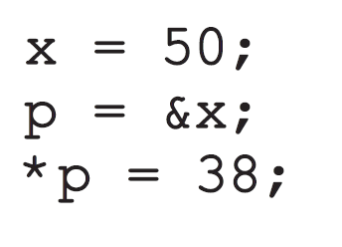
Example (4)
Next slides will show these three lines being executed, one by one.

Slide 10
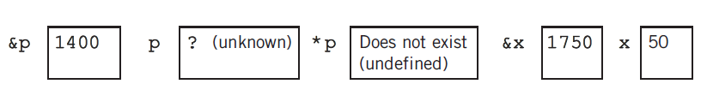
Example (4)
50
X = 50;

Slide 11

P = &x;
Example (4)
1750
50

Slide 12

*P = 38;
Example (4)
1750
38

Slide 13
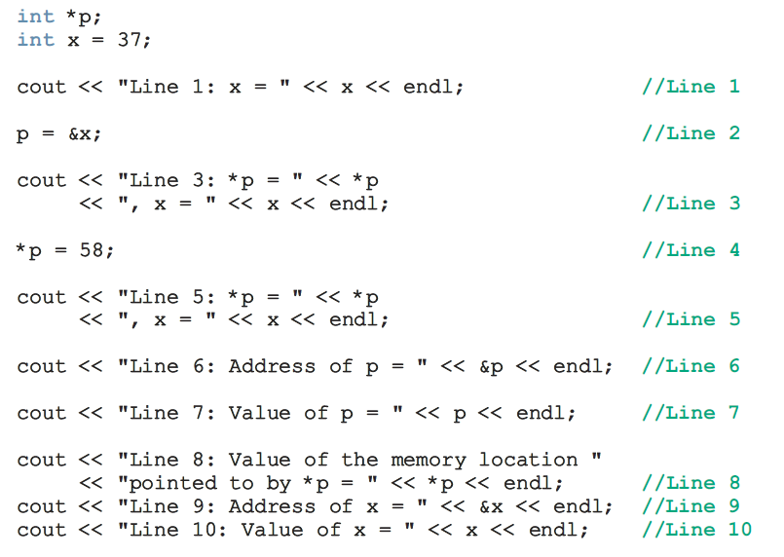
Example (5)
Determine output

Slide 14
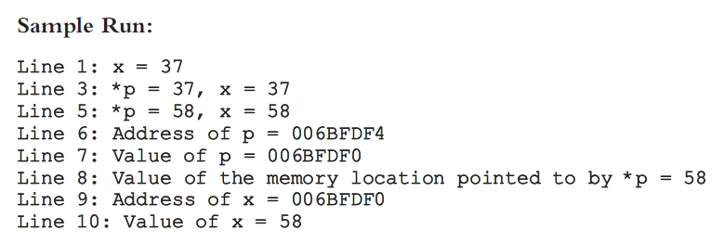
Example (5)

Slide 15
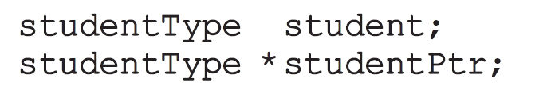



Accessing member variables through object pointers

Slide 16
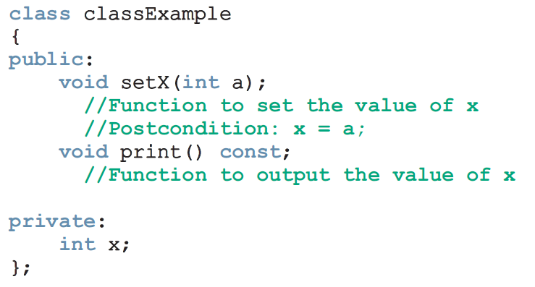
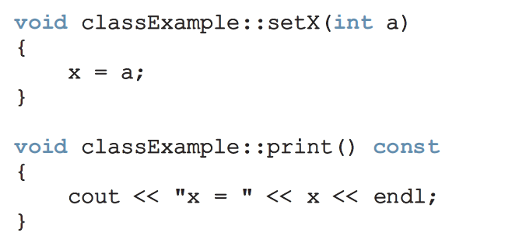
Example (6)

Slide 17
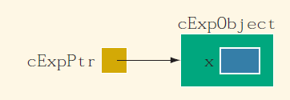
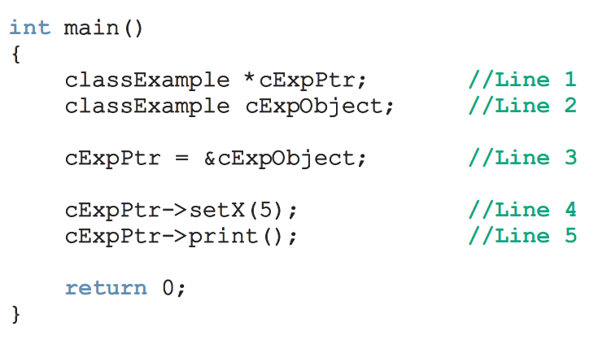
Example (6)
5

Slide 18
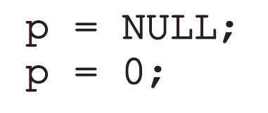
Initializing Pointer Variables

Slide 19

Dynamic Variables
What are they? Variables created during program execution
How to create them? Using pointers
new and delete commands

Slide 20
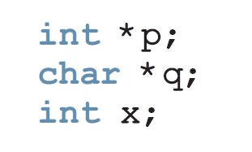
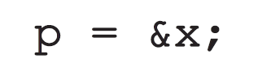
EXAMPLE (7)
Given the following declaration
This statement will assign the address of x to p

Slide 21
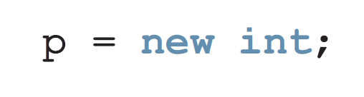
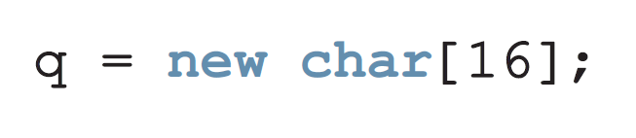
Example (7)
This statement creates a variable during program execution and stores the address of the allocated memory in p
Creates an array of 16 character components and stores the base address of the array in q

Slide 22
Because a dynamic variable is unnamed, it cannot be accessed directly. It is accessed indirectly by the pointer returned by new.

Slide 23
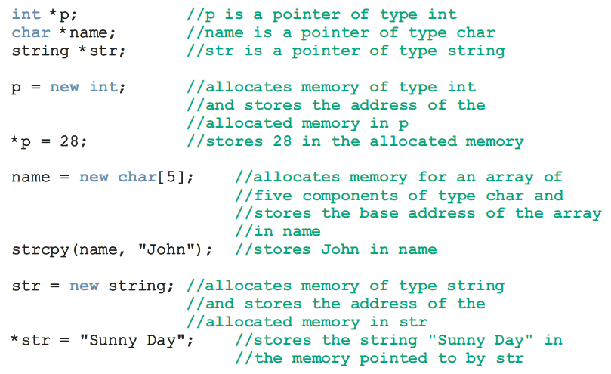
Example (8)

Slide 24
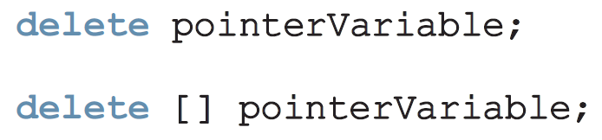
Why do we need delete?
Unused memory space that cannot be allocated leads to Memory Leak
Deallocate memory when it is no longer needed to avoid Memory Leak

Slide 25
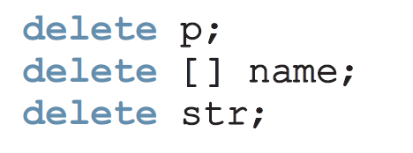
Example (10)

Slide 26
Issues with delete
Delete may result in dangling pointers
Set pointer to null after delete to avoid dangling pointers

Slide 27

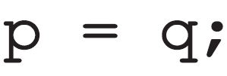
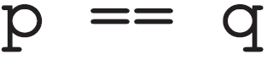
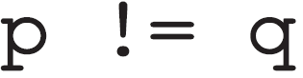
Operations on Pointer Variables
Assignment
Relational
Limited arithmetic

Slide 28
Operations on Pointer Variables
Limited Arithmetic
int* p; //Line1
p++; //Line2
p = p + 1; //Line3
p = p + 2; //Line4
Line2 and Line3 both increment by 4 bytes (because p is an int)
Line4 increments by 8 bytes

Slide 29
Operations on Pointer Variables
Limited Arithmetic
double* q; //Line1
q++; //Line2
q = q + 1; //Line3
Line2 and Line3 both increment by 8 bytes (because q is a double)

Slide 30
Operations on Pointer Variables
Limited Arithmetic
char* charPtr; //Line1
charPtr++; //Line2
chatPtr = chatPtr + 1; //Line3
Line2 and Line3 both increment by 1 byte (because charPtr is a char)

Slide 31
Dynamic Arrays
Two ways to iterate over them:
Arithmetic
Indexing

Slide 32
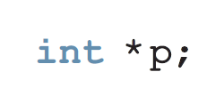

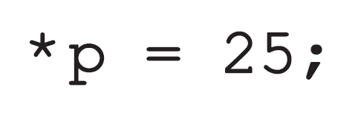
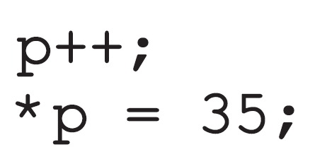
Dynamic Arrays
Arithmetic
Eventually you’ll be unable to track where you are …

Slide 33
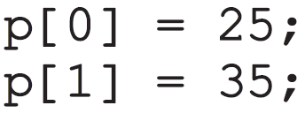
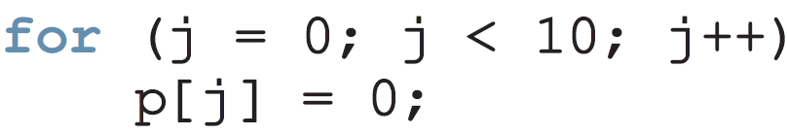
Dynamic Arrays
Indexing

Slide 34
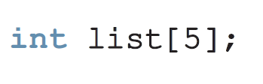
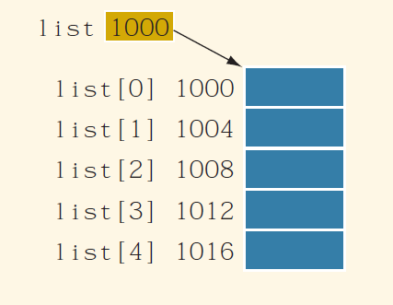
Recall Arrays

Slide 35
Recall Arrays
This value, 1000, however cannot be altered. So arithmetic operations cannot be applied to list.
But something like:
int *p;
p = list;
p++;
Is possible

Slide 36
An array name is a constant pointer

Slide 37
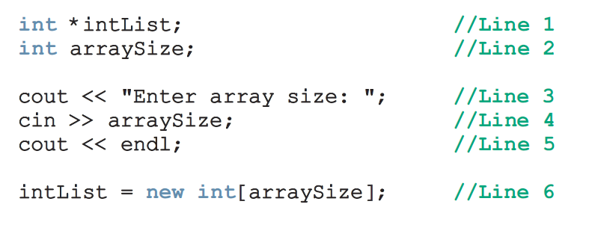
Getting Array Size from User

Slide 38
Functions & pointers

Slide 39
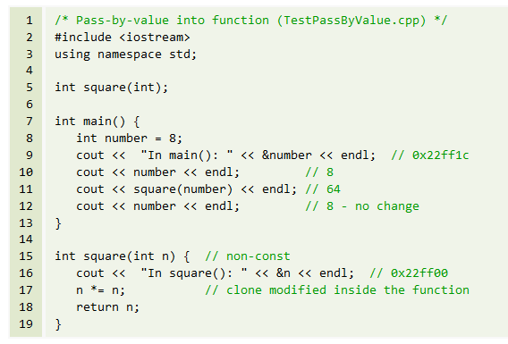

Slide 40
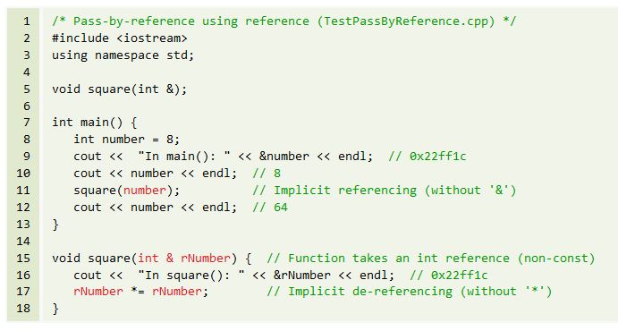

Slide 41
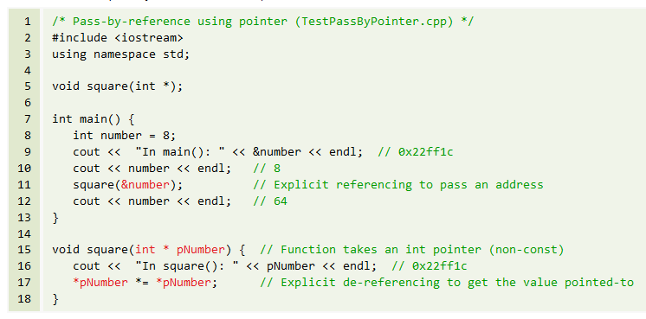

Slide 42
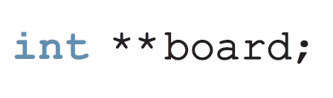
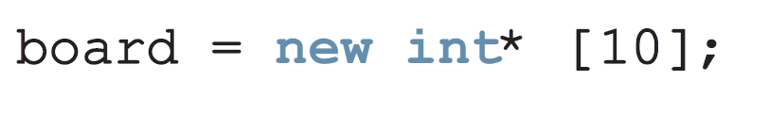
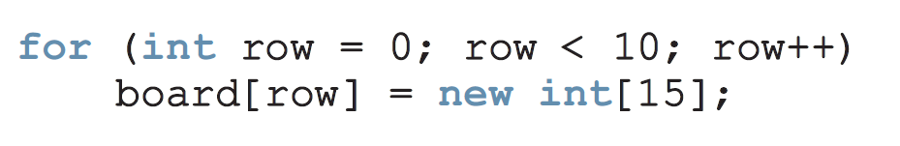
Dynamic Two Dimensional Arrays

Slide 43
Complete program

Slide 44
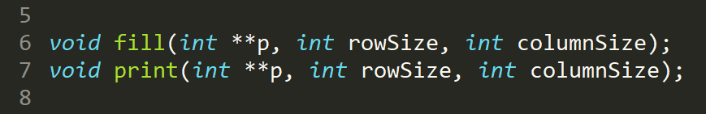

Slide 45
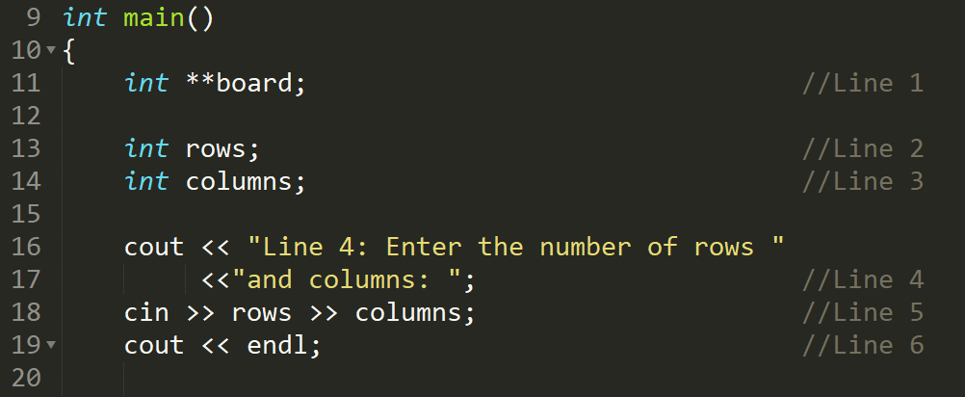


Slide 46



Slide 47


Slide 48
Practice Question (1)
int main()
{
int arr[5] = { 10, 20, 30, 40, 50 };
int num = 25;
int* ptr;
ptr = arr;
ptr++;
*ptr = *ptr * 2;
ptr = &num;
num++;
arr[4] = *ptr;
for (int i = 0; i < 5; i++)
cout << arr[i] << " ";
}

Slide 49

Practice Question (1)
int main()
{
int arr[5] = { 10, 20, 30, 40, 50 };
int num = 25;
int* ptr;
ptr = arr;
ptr++;
*ptr = *ptr * 2;
ptr = &num;
num++;
arr[4] = *ptr;
for (int i = 0; i < 5; i++)
cout << arr[i] << " ";
}

Slide 50
Practice Question (2)
int num1 = 10; int num2 = 20;
int main() {
int * ptr = &num1; cout<<*ptr<<"\t"<<ptr<<"\t"<<&ptr<<endl;
checking(ptr); cout<<*ptr<<"\t"<<ptr<<"\t"<<&ptr<<endl;
return 0;
}
void checking(int *ptr2)
{ cout<<*ptr2<<"\t"<<ptr2<<"\t"<<&ptr2<<endl;
ptr2 = &num2;
cout<<*ptr2<<"\t"<<ptr2<<"\t"<<&ptr2<<endl;
}

Slide 51
Lecture content adapted from chapter 13 of D.S. Malik and chapter 9 of Tony Gadis

